Slide 1
Personal Indicators of Heart Disease
Which variables have a significant effect on the increased chance of heart disease?

Slide 2
Data Set
2020 annual CDC survey of over 9k adults related to their health status
Variables include BMI, smoking, alcohol drinking, physical health over 30 days, mental health over 30 days, difficulty walking, sex, age, race, if their diebetic, physical activity over 30 days, general health, sleep time per day, asthma, kidney disease, and skin cancer.
Source: “https://www.kaggle.com/datasets/kamilpytlak/personal-key-indicators-of-heart-disease”

Slide 3
Data Cleaning
Checked for duplicates
Checked for missing data
Checked for inconsistencies in categorical and numerical data

Slide 4
Null Values and duplicates
There were no null values so I didn’t have to replace any missing data
I found there were 27 duplicates so I dropped them
Data Inconsistencies in categorical features
For categorical data I replaced descriptive data value with a more manageable value.
df["Diabetic"] = df["Diabetic"].replace(to_replace = ("No, borderline diabetes"), value = "Borderline")
df["Diabetic"] = df["Diabetic"].replace(to_replace = "Yes (during pregnancy)", value = "During Pregnancy")

Slide 5
Data Inconsistencies in numerical features
BMI feature had a very high outlier
Chose to drop two points because they had a very abnormally high BMI with no heart disease which is highly unlikely
The minimum BMI also seemed very abnormally low
Decided not to drop this point because while such a low BMI is not common I discovered after exploring the data point more they did have heart disease and a lot of other unhealthy indicators which led me to believe this was an accurate data point.

Slide 6
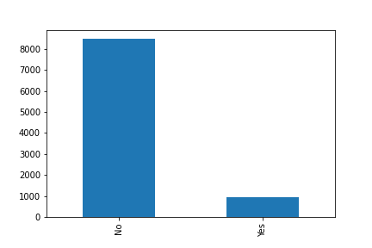
Univariate Visual of Heart Disease
Shows consistent data
Significantly more people don’t have heart disease compared to those who do

Slide 7
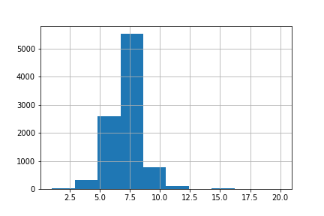
Univariate Visualization of Sleep Time
Shows that most of the data points fall between 5 and 10 hours of sleep
There are a few outliers but while they may be uncommon I do believe they are possible

Slide 8
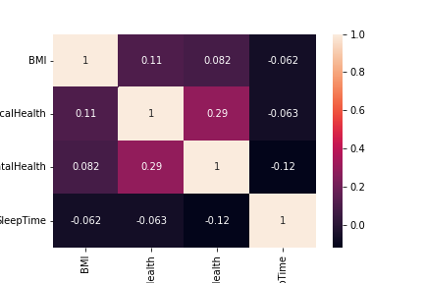
Heatmap
After visualizing correlation in a heat map I determined that none of the numerical features seem to have a moderate or strong correlation between each other

